Slide 1


EPIC: Microbial Community Metagenomics with the bioBakery and Bioconductor
Levi Waldron and Curtis Huttenhower
June 6-7, 2018
Notes:
Hi. I’d like to introduce you to MultiAssayExperiment, a framework for the representation and analysis of multi-omics experiments in Bioconductor.

Slide 2

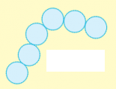





What is a microbiome?
The “micro” is from microbiology
Bacteria
Archaea
Fungi (e.g. yeast)
Viruses
Protozoa
A microbiome is a community in an environment
Some definitions
include community
genes and gene products as well
(RNAs, proteins, metabolites)
Cells from more than one species make a microbial community
Could be two, or three, or 100s…
Many cells of one microbial species make a monoculture

Slide 3

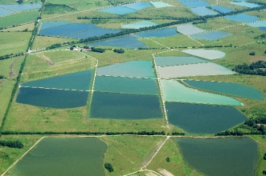

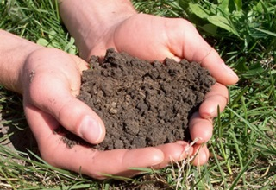
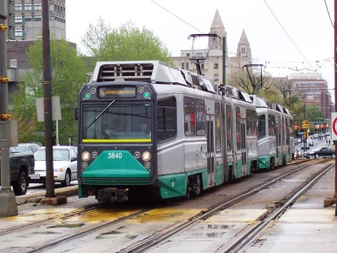
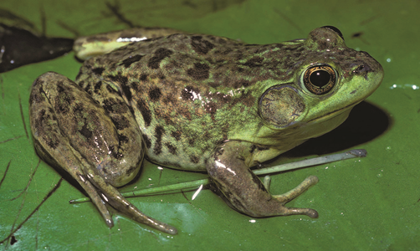


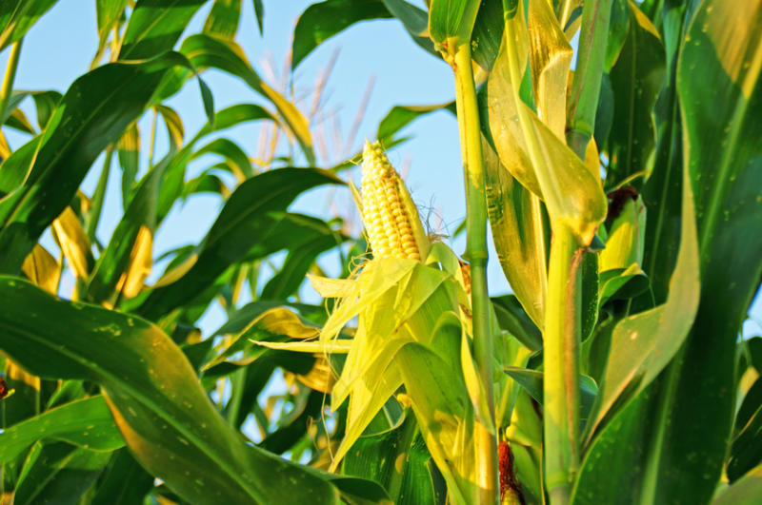
Many environments have microbiomes
Natural environments
Built environments
Host environments

Slide 4
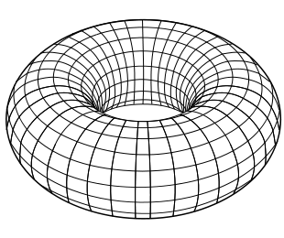
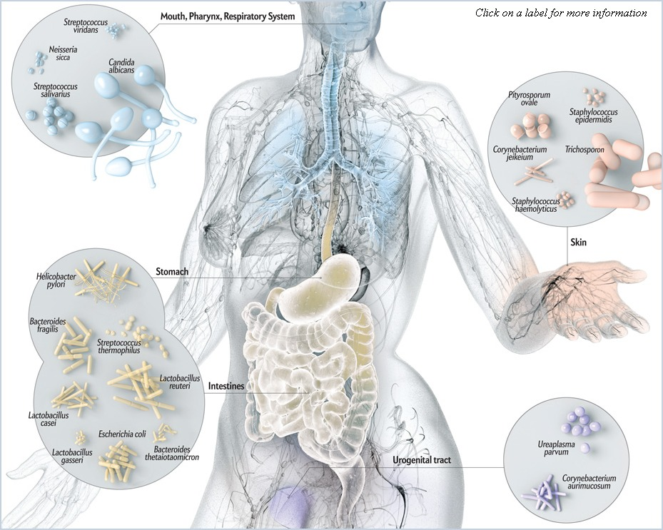
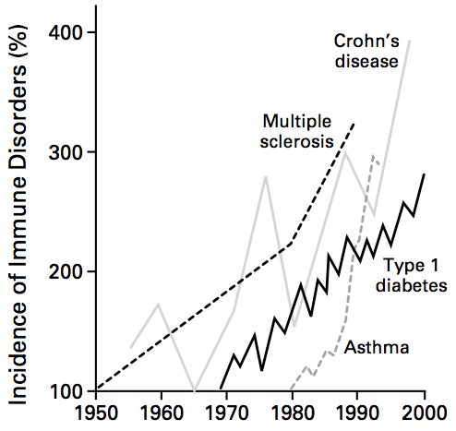
And of course, the human microbiome
1-10x the cells of the human body
1-2 kg of bugs, mostly in the gut
100s of species, millions of genes
A “forgotten organ”
Aids in metabolism and immunity
Covers “topologically exposed” surfaces
Bach NEJM 2002

Slide 5
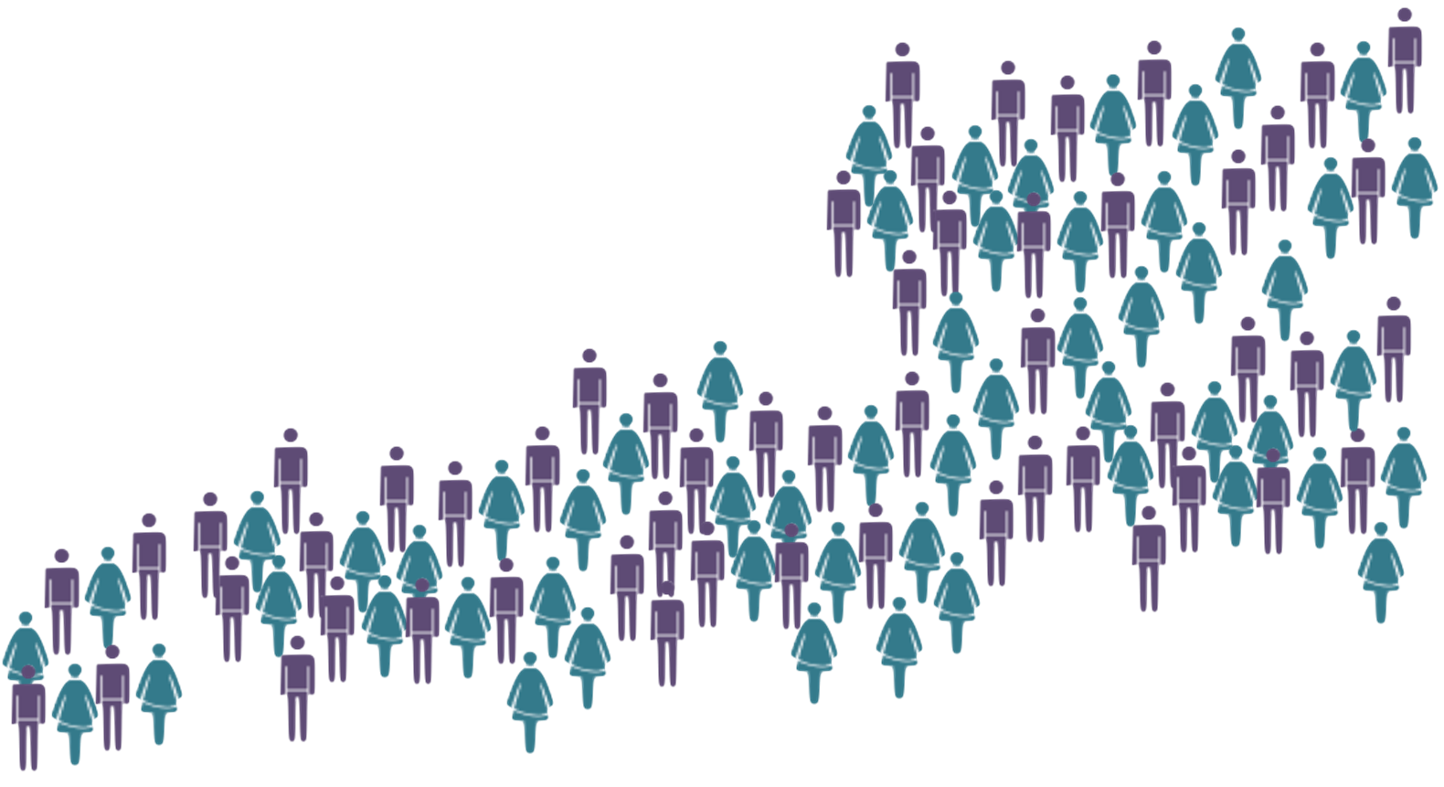
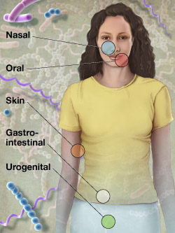


The NIH Human Microbiome Project (HMP1)
Expanded
(HMP1-II)
What is a “normal” human microbiome?
300 healthy human subjects
Multiple body sites (15 male, 18 female)
Up to 3 sampling visits over ~1 year
Clinical metadata
From the HMP1 publication (2012)
Shotgun metagenomes | ~700
From the HMP1-II publication (2017)
Shotgun metagenomes | ~2,400
(HMP1 2012)
(HMP1-II 2017)

Slide 6
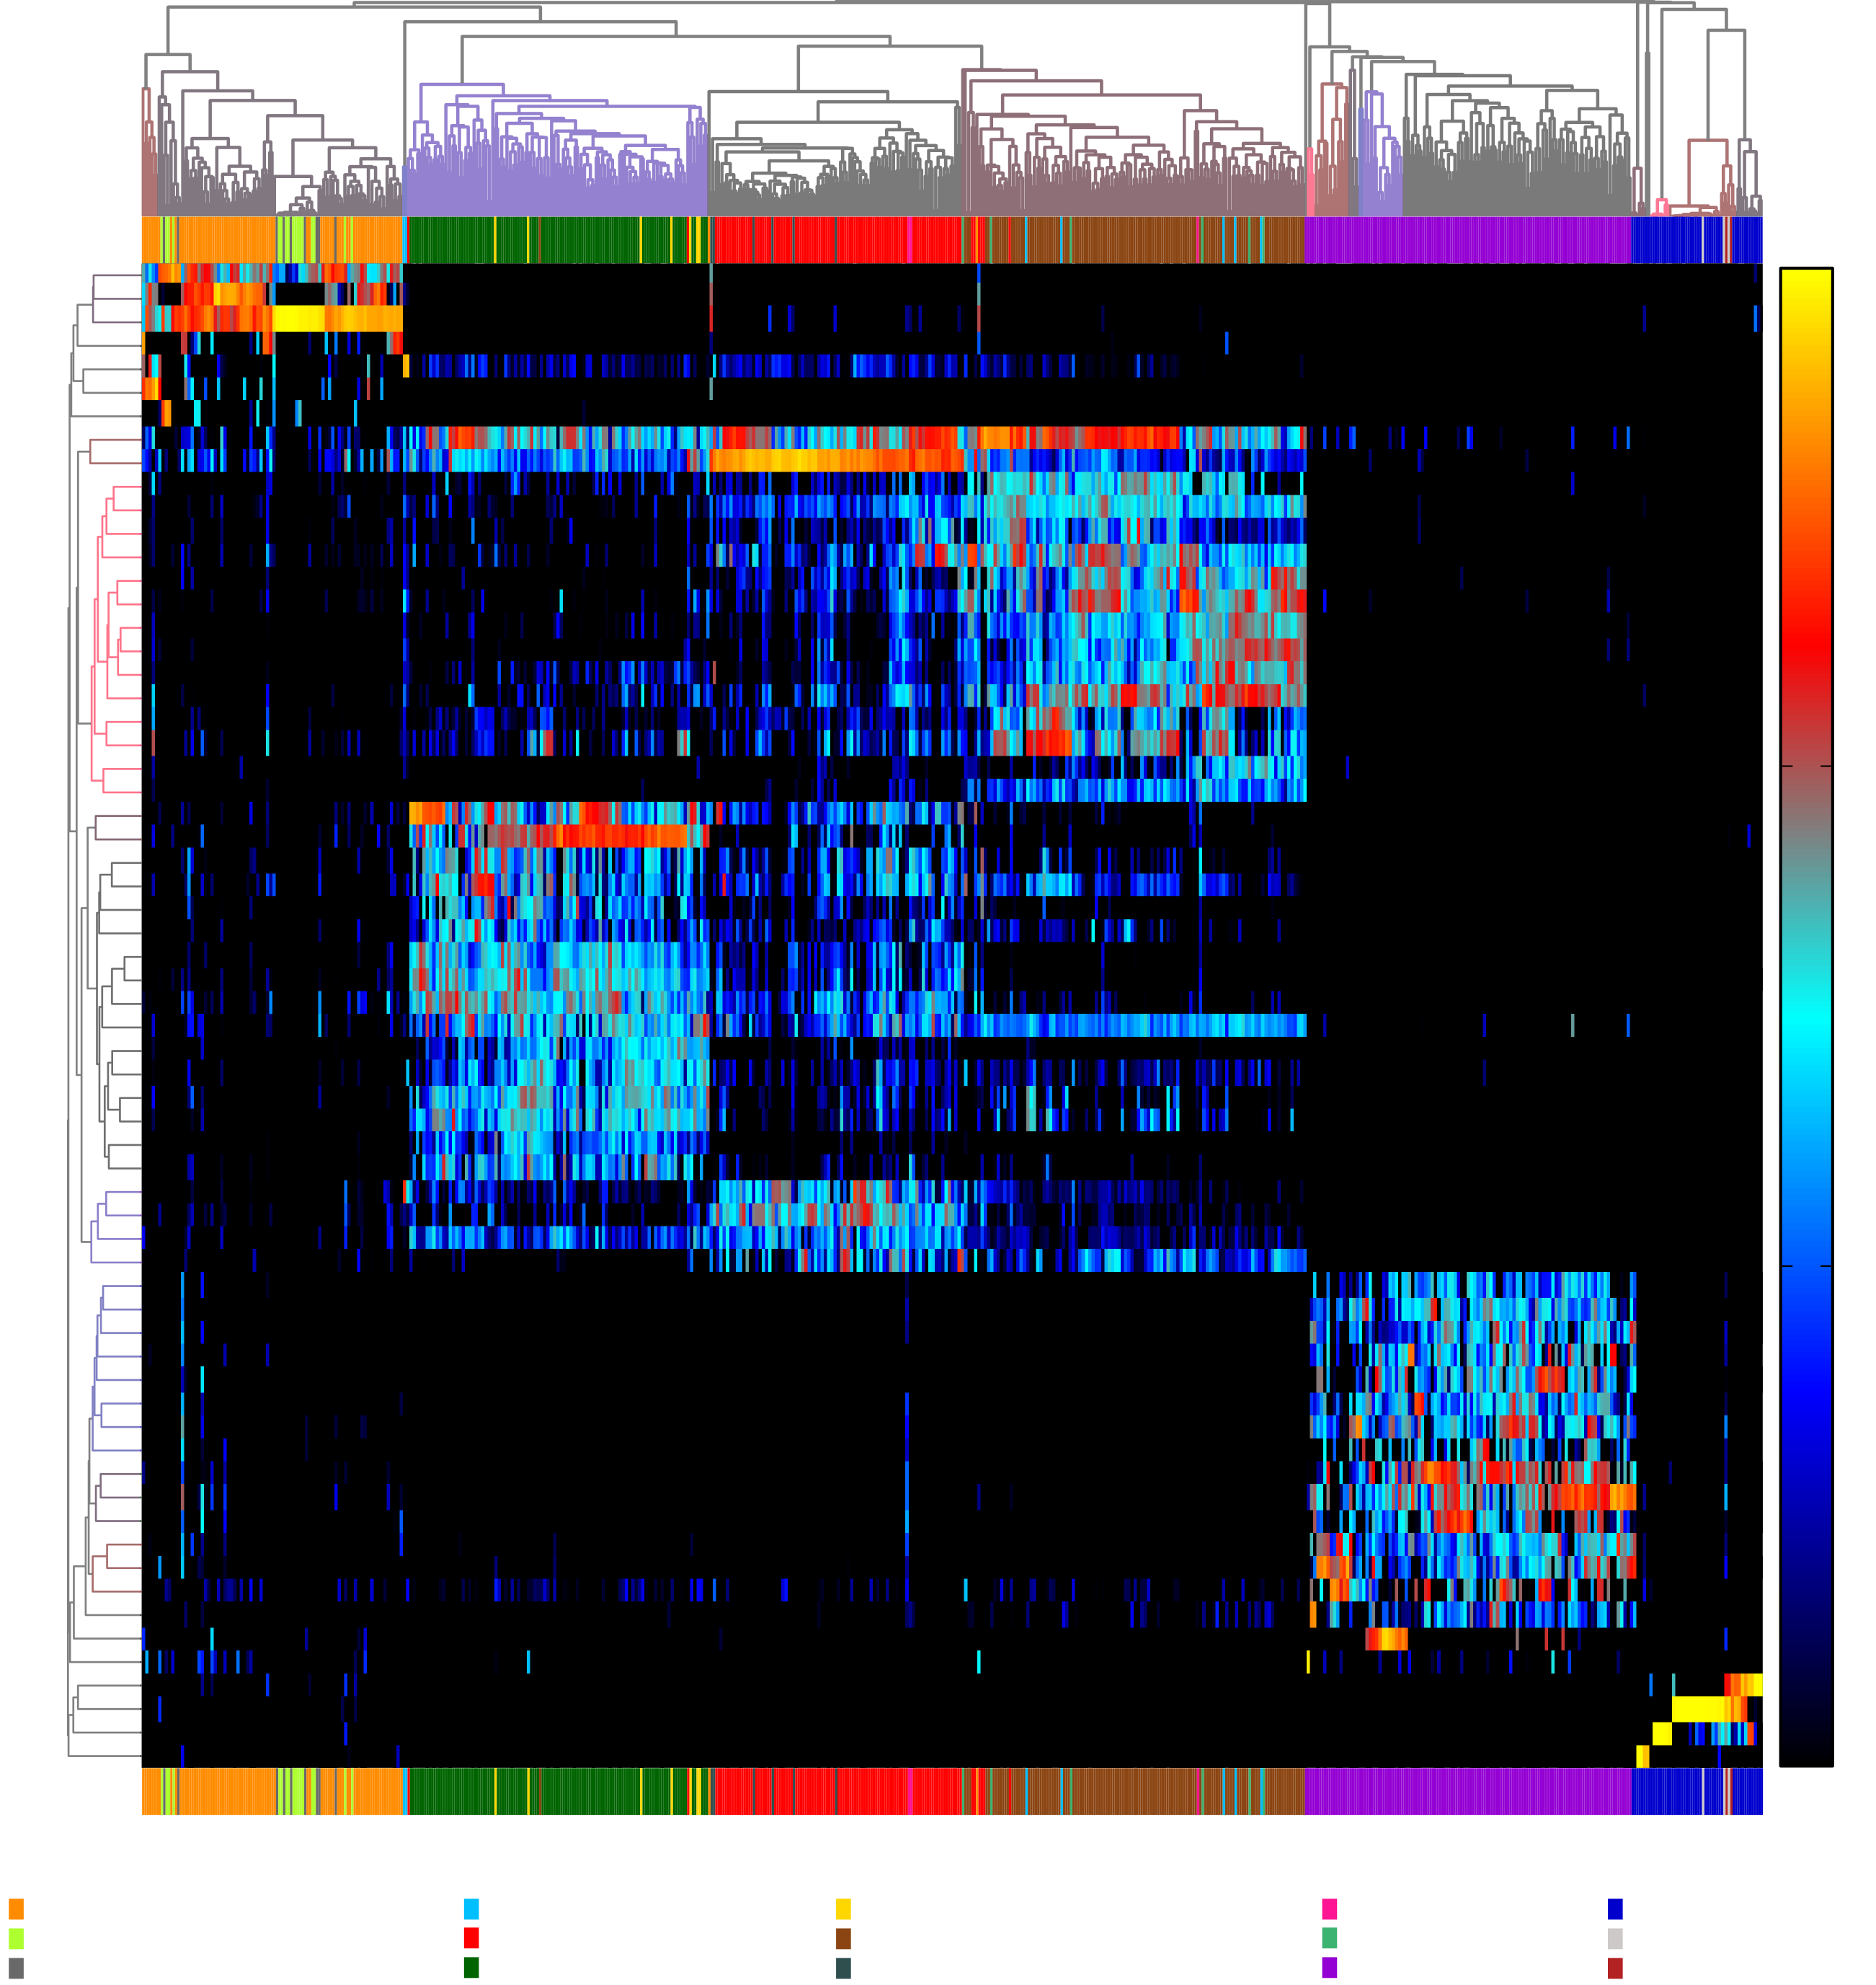

Ecology of ~700 human microbiome samples (HMP)
100%
Skin (nares)
Oral (plaque)
Oral (cheek)
Oral (tongue)
10%
The 64 most abundant
species across HMP samples
1%
Gut (stool)
Nicola
Segata
0.1%
Vaginal (fornix)
←700 samples →
MetaPhlAn(2) & hclust2

Slide 7
Properties of microbiome data

Slide 8
Properties of microbiome data
N samples
sample metadata
(e.g. subject, diagnosis, environment type)
M stratified
features
N samples
Compositional
measurements
(e.g. %, copies
per million)
Σ_{M}=k
Σ_{M}=k
10,000
1,000
100
10
1
0
100s – 1Ks of
taxa
1Ks – 10Ks of
functional modules
(e.g. pathways)
100Ks – 1Ms of
genes
A1
A1|B1
A1|B2
A2
A2|B3
A2|B4
A3
A3|B5
A3|B6
M ≫ N
features
0
10,000 1,000 100 10 1
Sparsity
Large dynamic range

Slide 9

Why microbiome data are compositional
Microbial Community 1
Microbial Community 2
Fixed sequencing depth
(here, 4 reads/sample)
# of reads ≪ # of cells
(millions vs billions)
Random sampling suggests
Proportions, not counts

Slide 10
Why microbiome data are compositional
Microbial Community 1
Microbial Community 2
50%
50%
50%
50%
Fixed sequencing depth
(here, 4 reads/sample)
# of reads ≪ # of cells
(millions vs billions)
Random sampling suggests
Proportions, not counts

Slide 11
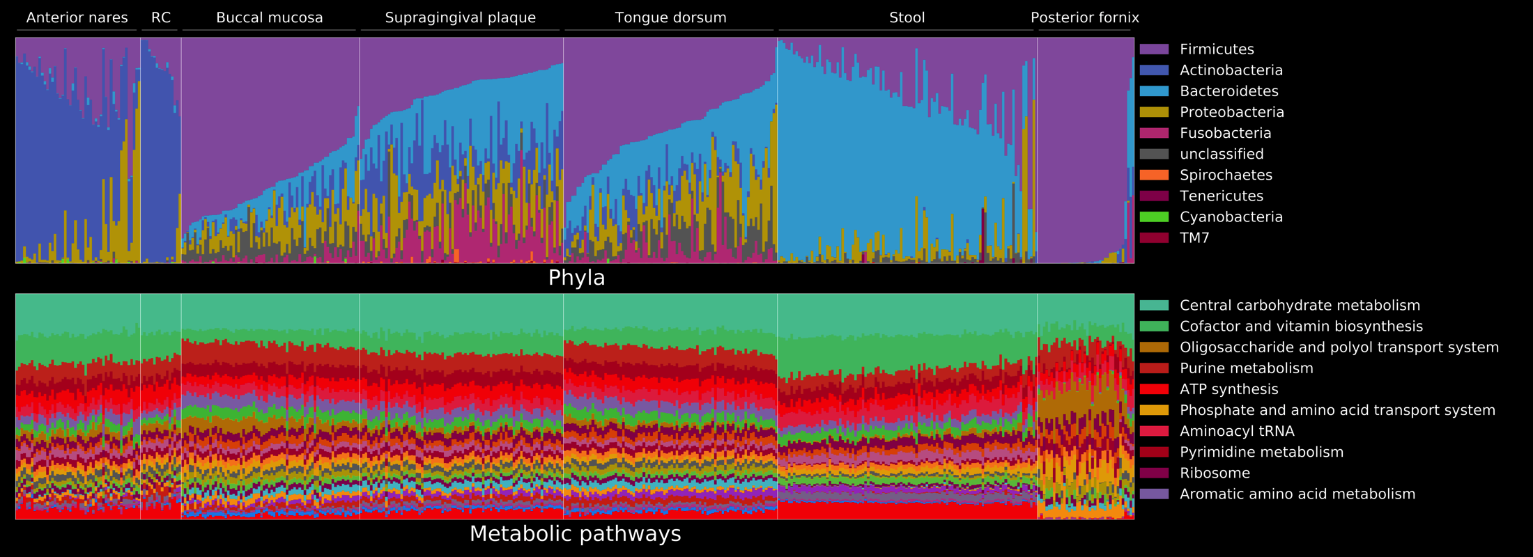
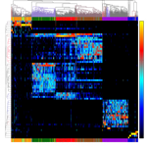
Comparing compositions of phyla & pathways (HMP)
← Subjects →
Firmicutes
← Phylum abundance →
← Phylum abundance →
Bacteroidetes
HMP
Nares
Skin
Oral (BM)
Oral (SupP)
Oral (TD)
Gut
Vaginal
← Pathway abundance →
← Pathway abundance →
← Subjects →

Slide 12
Describing
microbiome data

Slide 13
Describing microbiomes: abundance and prevalence
Abundant but not prevalent
Prevalent but not abundant
Abundant and prevalent

Slide 14
Describing microbiomes: within-sample diversity
Broadly, the number and distribution of species in a sample
Also community composition or structure
Qualitatively diverse
Taxonomically diverse
Phylogenetically diverse
Quantitatively diverse
Taxonomically diverse
Not diverse

Slide 15
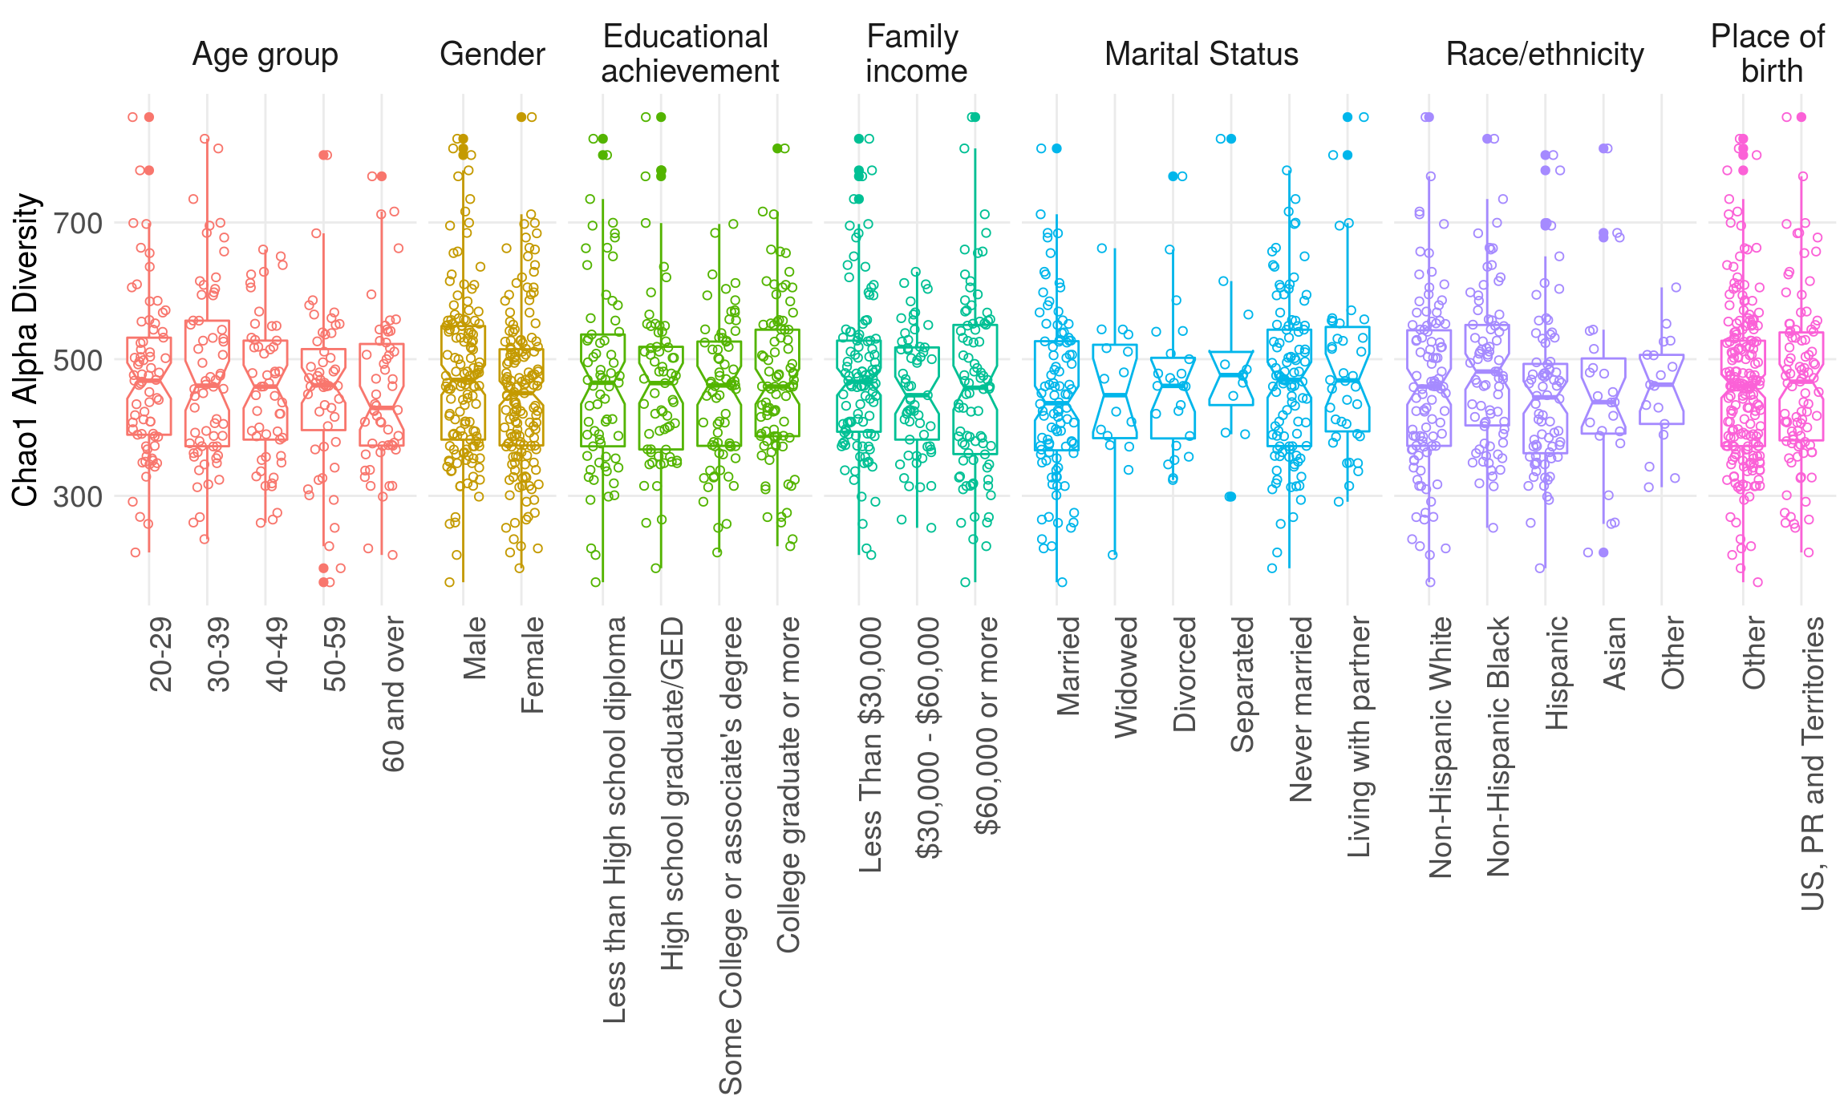
Alpha diversities

Slide 16
Comparing microbiomes: between-sample diversity
Sample 1
Sample 2
Qualitatively diverse
Taxonomically diverse
Quantitatively diverse
Taxonomically diverse
Quantitatively diverse
Phylogenetically diverse

Slide 17


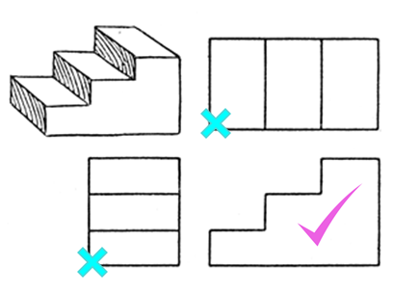
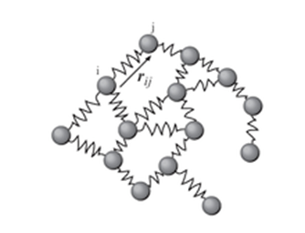
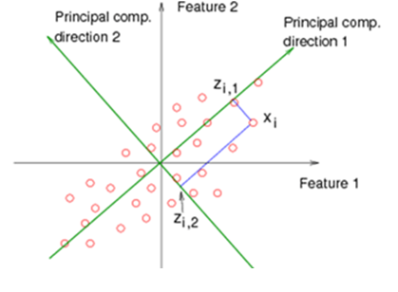
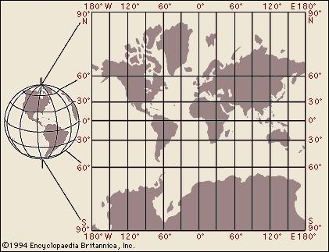
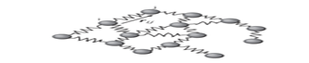
Comparing microbiomes: Ordination
N samples
N samples
M features
(M ≫ N)
Convert to
distance matrix
N samples
Principal Components Analysis (PCA)
Multidimensional scaling (MDS)
Principal Coordinates Analysis (PCoA)

Slide 18
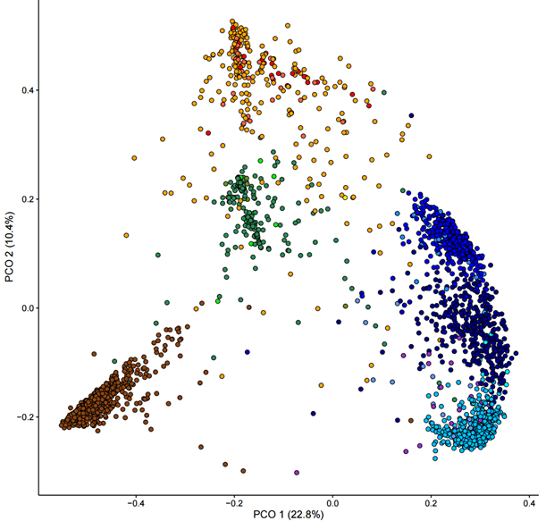
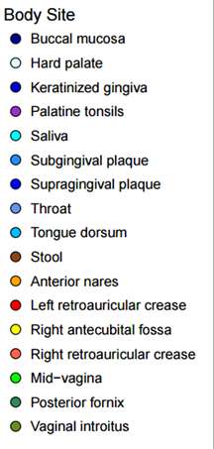

HMP samples ordinated: MDS on Bray-Curtis distance
Anterior
nares
Posterior
fornix
Plaque
Cheek
HMP
Jason
Lloyd-Price
(HSPH/Broad)
Stool
Tongue

Slide 19
Unsupervised clustering
n=3,667 human gut samples
Pasolli/Schiffer/Manghi et al., Accessible, curated metagenomic data through ExperimentHub, Nat. Meth. 2017

Slide 20
Modeling with
microbiome data

Slide 21
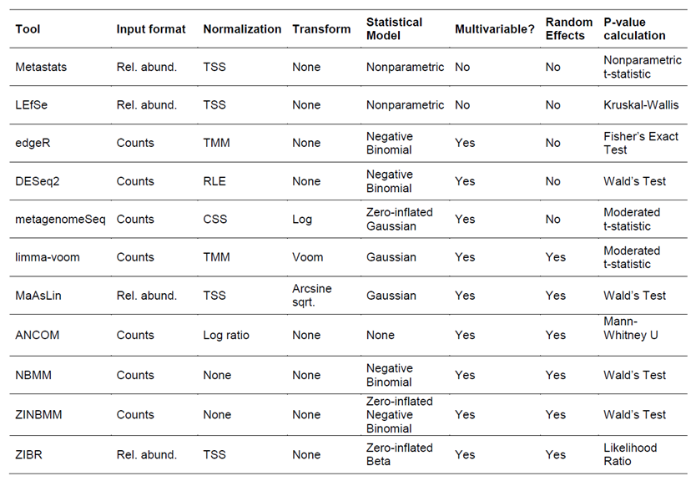
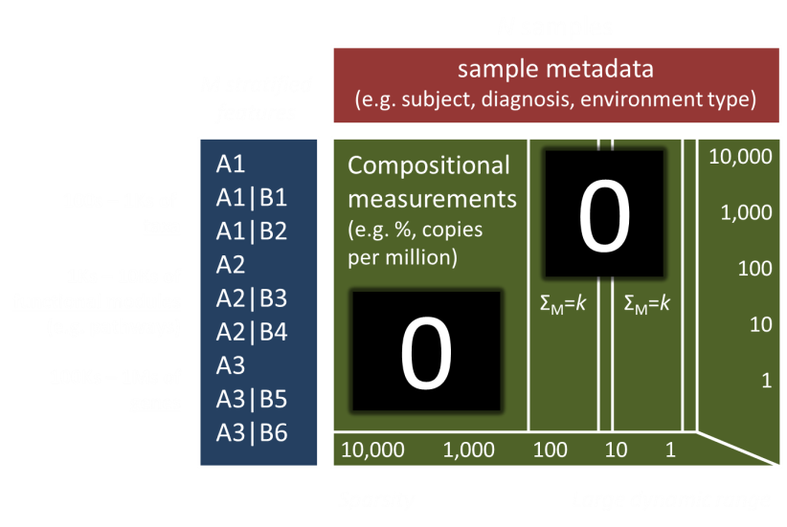
Multivariable association: caveats + methods
Compositionality Can induce spurious correlation between features
Expansion of bug X ~ loss of non-X species
Sequencing depth Normalization needed to compare samples
Zeroes of absence vs. non-detection Zero-inflated models; seq. depth as a covariate
Summary from
Mallick et al.
Genome biology
18.1 (2017): 228.
Mean-variance dependency Use a transformation to variance-stabilize the data
Batch effects and biases From extraction, sequencing, and bioinformatics
Loss of power From having many more features than samples

Slide 22
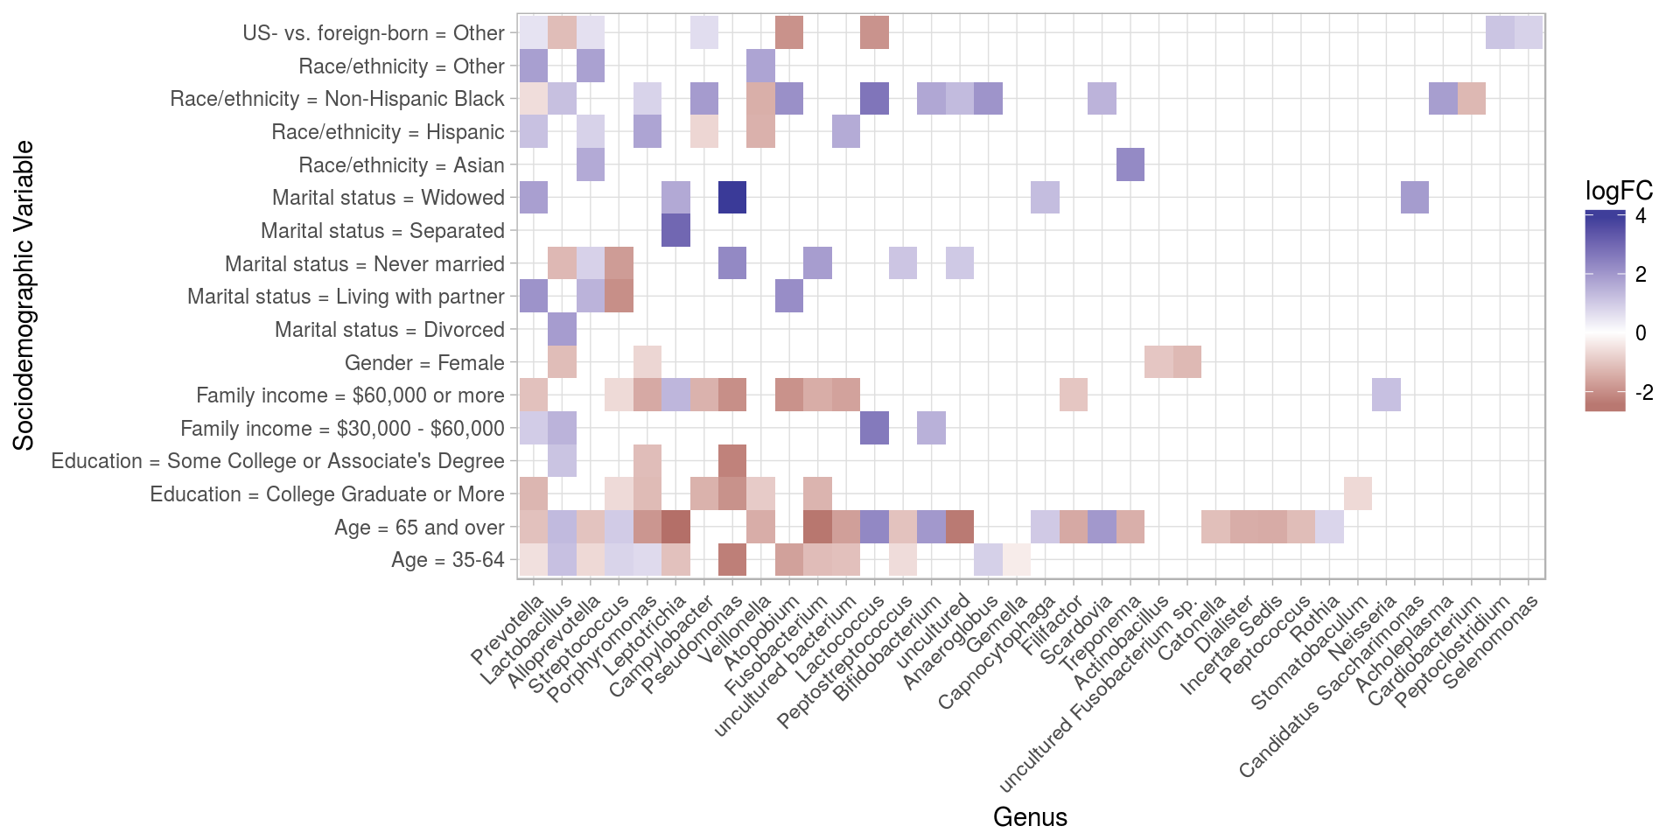
Screening for Differential Abundance
Renson et al. Sociodemographic variation in the oral microbiome, bioRxiv 189225

Slide 23
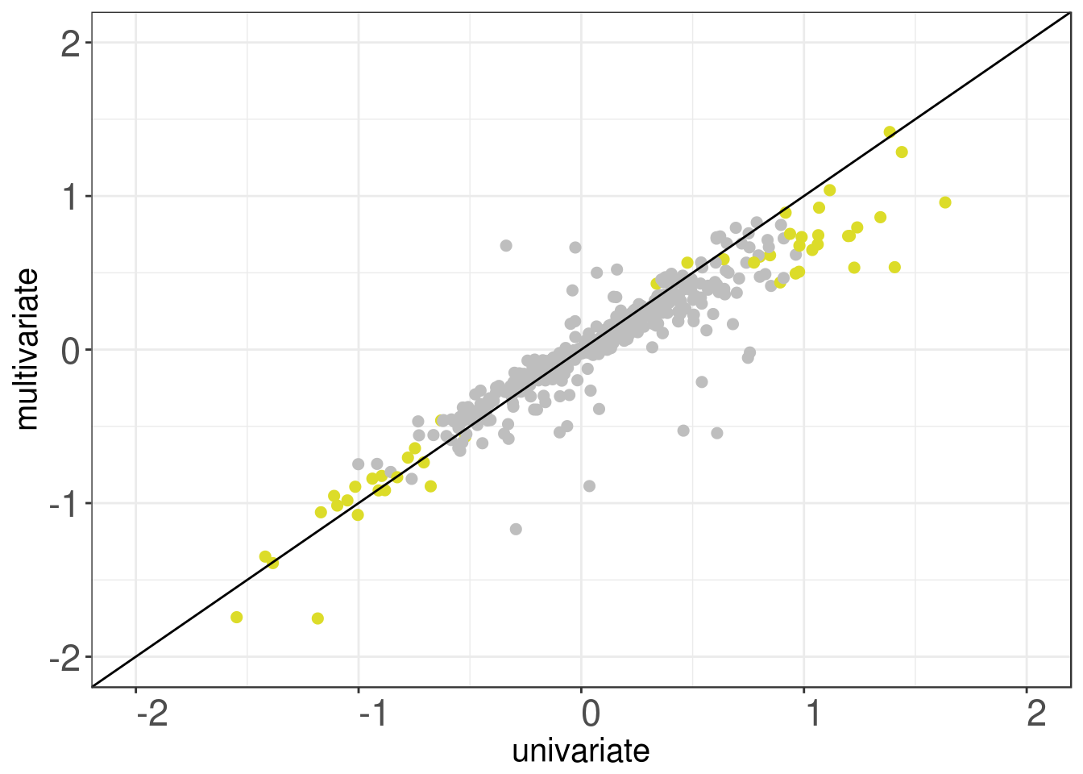
Correcting for confounding
Multivariate log(Fold Change)
Univariate log(Fold Change)
Beghini et al. Tobacco exposure is associated with oral microbiome anaerobiosis in the New York City Health and Nutrition Examination Study, 2013-2014

Slide 24
Today’s Outline
Methods (all in R/Bioconductor):
Exploratory data analysis
Distances and Principal Coordinates Analysis
Linear modeling for differential abundance (log-linear models, zero inflation)
Multi-omics analysis
Main tools:
curatedMetagenomicData (or your own data)
phyloseq
metagenomeSeq
DESeq2
MultiAssayExperiment

